Slide 1

A Post-processing Approach for Solar Power Combined Forecasts of Ramp Events
Mohamed Abuella
Supervised by:
Prof. Badrul Chowdhury
A dissertation submitted to the faculty of
The University of North Carolina at Charlotte
in partial fulfillment of the requirements
for the degree of Doctor of Philosophy in
Electrical Engineering
Charlotte
October 1st, 2018

Slide 2
Highlights
A post-processing approach combines and improves solar power forecasts.
The approach also adjusts the combined forecasts in terms of ramp events.
A classification of all possible thresholds and classes of ramp event forecasts.
A customized cost function for imbalanced classification of ramp events.
Suitable metrics for the feature selection process and performance evaluation.
An uncertainty analysis for probabilistic forecasts of solar power ramp events.

Slide 3

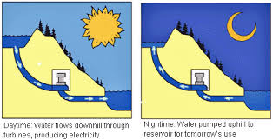




Motivation
Why Forecast?
P_{Supply} = P_{Demand} +P_{Loss}
PV Solar Power Generations
are Too Variable
Coordination with Operating Reserves and Energy Storage
Systems
Reducing
Cost
and Pollution
Illustration of the motivation of PV solar power forecasts

Slide 4
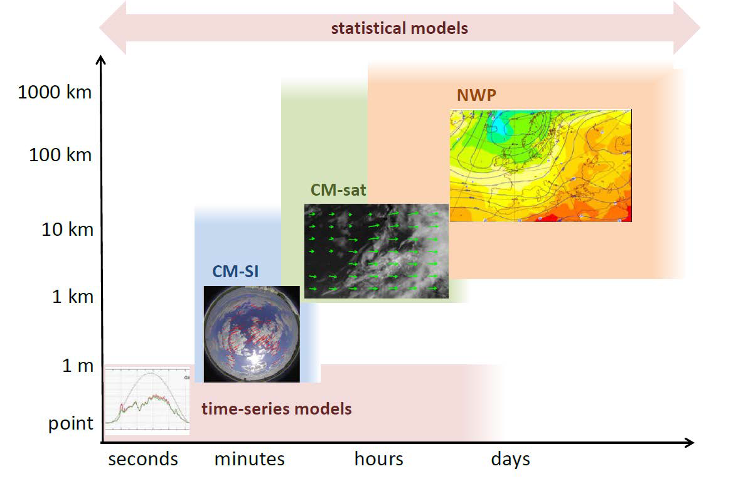
Literature Review
Taxonomy of solar forecasting methods based on temporal and spatial resolution#
CM-sat: cloud motion by satellite images;
CM-SI: cloud motion by sky-imagers
NWP: Numerical weather prediction Systems
Statistical models: blending and post-processing all of the methodologies.
# M. Sengupta, A. Habte, C. Gueymard, S. Wilbert, and D. Renne, Best practices handbook for the collection and use of solar resource data for solar energy applications," Tech. rep., National Renewable Energy Lab.(NREL), Golden, CO (United States), 2017
Yang, D., Kleissl, J., Gueymard, C. A., Pedro, H. T., & Coimbra, C. F. (2018). History and trends in solar irradiance and PV power forecasting: A preliminary assessment and review using text mining. Solar Energy. (**This review paper published in 2018, and reviewing 1000 solar forecast studies).

Slide 5
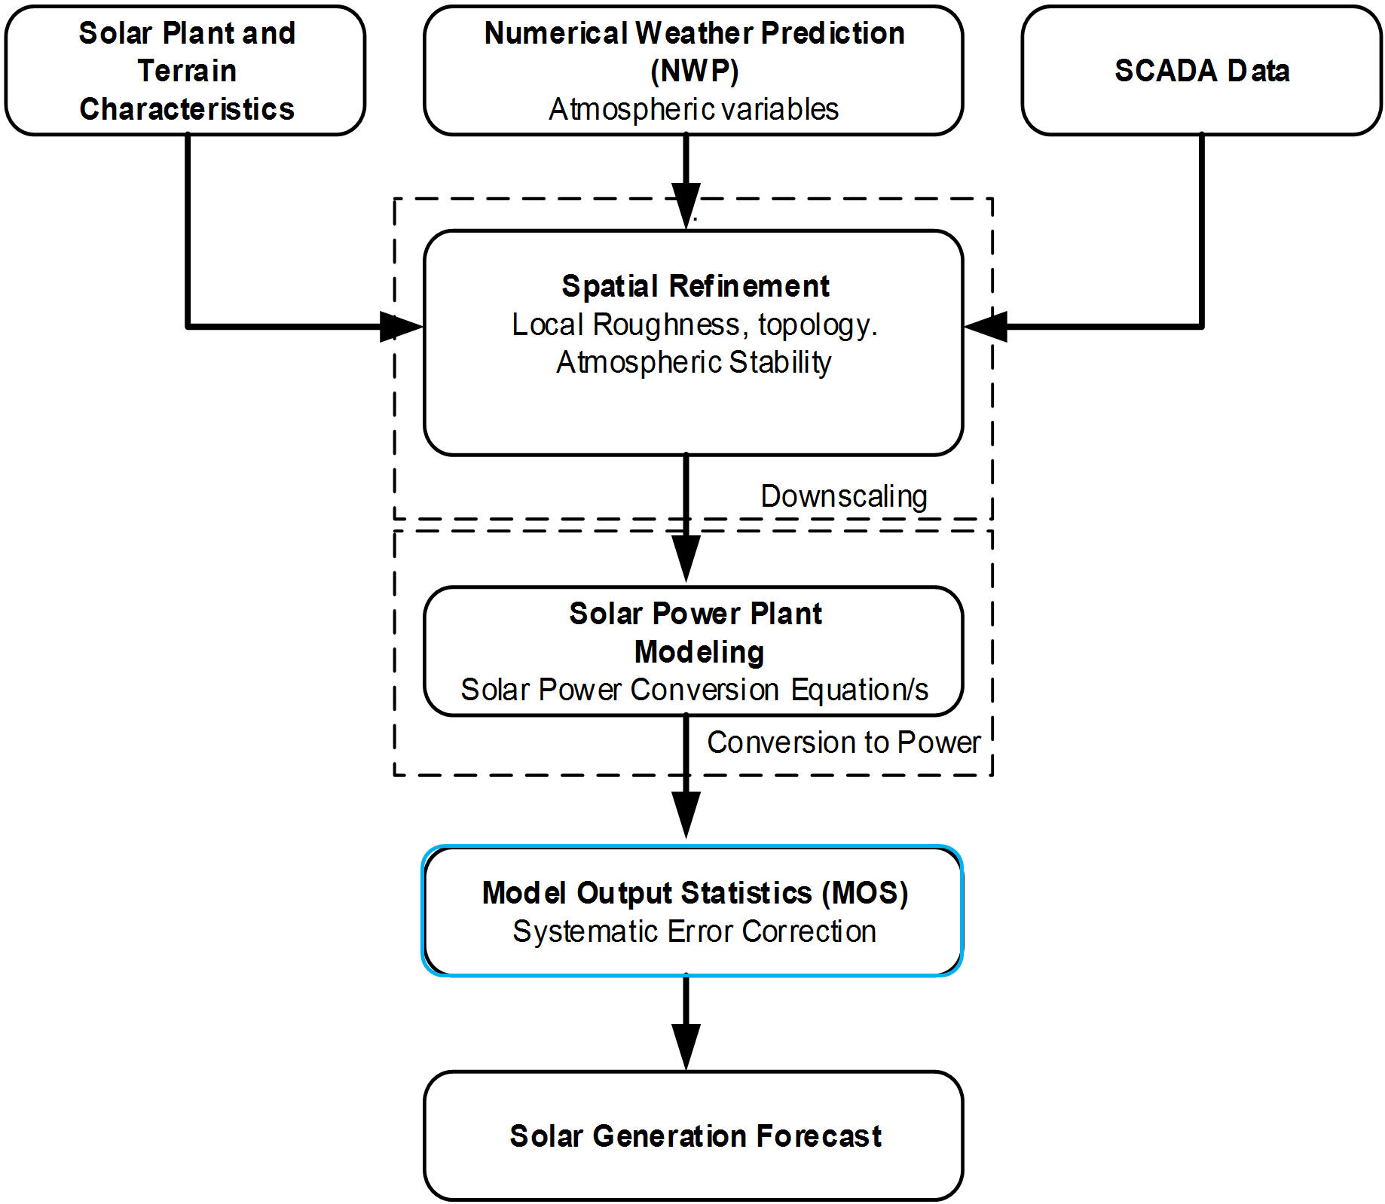
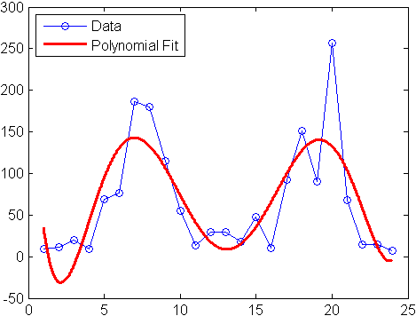
Problem Statement and Contribution
The Problem Statement
Combining of different forecasts can reduce the systemic bias of the individual models, boost the overall accuracy, and make the performance more robust, but it also smooths out the sharp changes of the forecasts, which leads to reduced accuracy of the combined forecasts for ramp events.
The post-processing methods (MOS) are affecting the ramp event forecasts by smoothing the sharp changes in the raw forecasts. (Kleissl 2013; Inman et al. 2013)
Kleissl, J. (2013). Solar energy forecasting and resource assessment. Academic Press.
Inman, R. H., Pedro, H. T., & Coimbra, C. F. (2013). Solar forecasting methods for renewable energy integration. Progress in energy and combustion science, 39(6), 535-576.

Slide 6
Problem Statement and Contribution
The Contribution
Due to the issue that was highlighted (Kleissl 2013; Inman et al. 2013), it is therefore, there is room for improvement by applying the proposed approach for adjusting the combined forecasts of solar power in terms of ramp events.
To the best of our knowledge, this is the first attempt to tackle this issue of the combined forecasts for solar power ramp events.
A post-processing approach combines and improves solar power forecasts.
The approach also adjusts the combined forecasts in terms of ramp events.
A classification of all possible thresholds and classes of ramp event forecasts.
A customized cost function for imbalanced classification of ramp events.
Suitable metrics for the feature selection process and performance evaluation.
An uncertainty analysis for probabilistic forecasts of solar power ramp events.

Slide 7
Graphical Abstract of the Proposed Adjusting Approach
Flowchart of Solar Power Forecasts

Slide 8
Graphical Abstract of the Proposed Adjusting Approach
Day
Statistical
-
ahead Forecasts
Weather Data
&
including the past forecasts
(
NWP
AI Models
)
Outcomes
Ramp Rates of
:
MLR
,
ANN
,
SVR
Day
-
ahead
Random
Forecasts
Forest
Combining by
fit by
Adjusted Hour
PV System
-
Data
Random Forest
MSE
ahead Forecasts
&
F
Persistence
Ramp Rates of
MSE
Hour
RR
Hour
-
ahead
Model
-
ahead Forecasts
including the past forecasts
Forecasts
Outcomes
Persistence and
:
Combined Forecasts
Forecasting Stage
Combining Stage
Adjusting Stage
Block diagram of the adjusting approach

Slide 9
Graphical Abstract of the Proposed Adjusting Approach
•
PV System Data
•
Measured PV power output
Location and modules type
,
Pre
-
orientation
,
tilt
Processing
Forecasting Models
,
..
etc
.
•
Outlier detection and
•
Persistence model
Weather Data
data cleansing
•
Statistical models
•
Solar irradiance
•
Feature engineering
•
Artificial intelligence models
•
Temperature
•
Cloud coverage
Combining the models’ outcomes
•
Humidity
by ensemble learning
•
...
etc
.
Point forecast
Post
-
•
Processing
•
Ensemble
Analog ensemble
Flowchart of Solar Power Forecasts
Probabilistic forecast
Day
Statistical
-
ahead Forecasts
Weather Data
&
including the past forecasts
(
NWP
AI Models
)
Outcomes
Ramp Rates of
:
MLR
,
ANN
,
SVR
Day
-
ahead
Random
Combining by
Forecasts
Forest
fit by
Adjusted Hour
PV System
Random Forest
-
Data
MSE
ahead Forecasts
&
F
Persistence
Ramp Rates of
MSE
Hour
RR
Hour
-
ahead
Model
-
ahead Forecasts
Forecasts
including the past forecasts
Outcomes
Persistence and
:
Combined Forecasts
Forecasting Stage
Combining Stage
Adjusting Stage
Block diagram of the adjusting approach

Slide 10


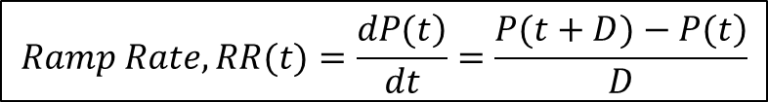
Solar Power Ramp Rates
Solar power ramp rate (RR) is the change of solar power during a certain time interval.
$$Ramp Rate, RR(t)=\frac{\left.dP(t\right)}{dt}=\frac{\left.P(t+D)−P(t\right)}{D}$$
$$ΔP$$
where P(t) is the solar power of the target hour, it can also be its forecast F(t); D is the time duration for which the ramp rate is determined.
$$Δt$$
For the illustrated cloudy day below:
Ramp rate, $\frac{ΔP}{Δt}$ = $\frac{0.2−0.85}{12:00−11:00}=−0.65 \left(−65\%\right) ramp down of its normal capacity, (pu/hr)$
Ramp rate, $\frac{ΔP}{Δt}$ = $\frac{0.48−0.1}{14:00−13:00}=+0.38 \left(+38\%\right) ramp up of its normal capacity, (pu/hr)$
Some ramps are with low rates, while others with high rates.
Ramp Events During a Cloudy Day

Slide 11
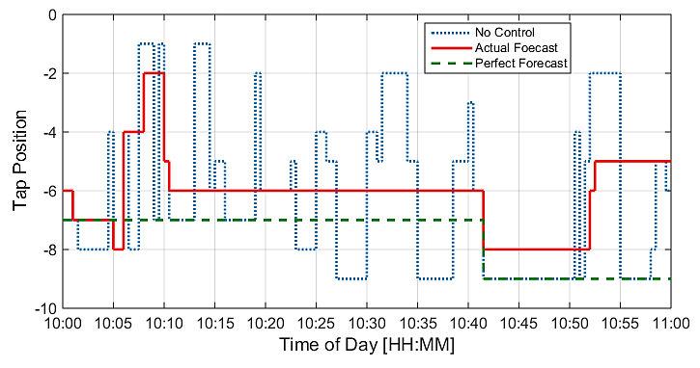
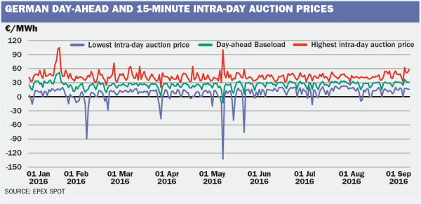
Potential Applications
There are several applications of power systems that rely on solar power ramp event forecasts
Distribution level:
Optimizing the voltage regulation equipment.
Control schemes of energy storage systems.
Optimizing the Transformer's Tap Changer position sequences using the solar forecast
Transmission / bulk level:
Trading & dispatching the operating reserve.
Managing the ramp capability / system flexibility with high-level of renewable energy integration.
EPEX: European power exchange spot trading

Slide 12
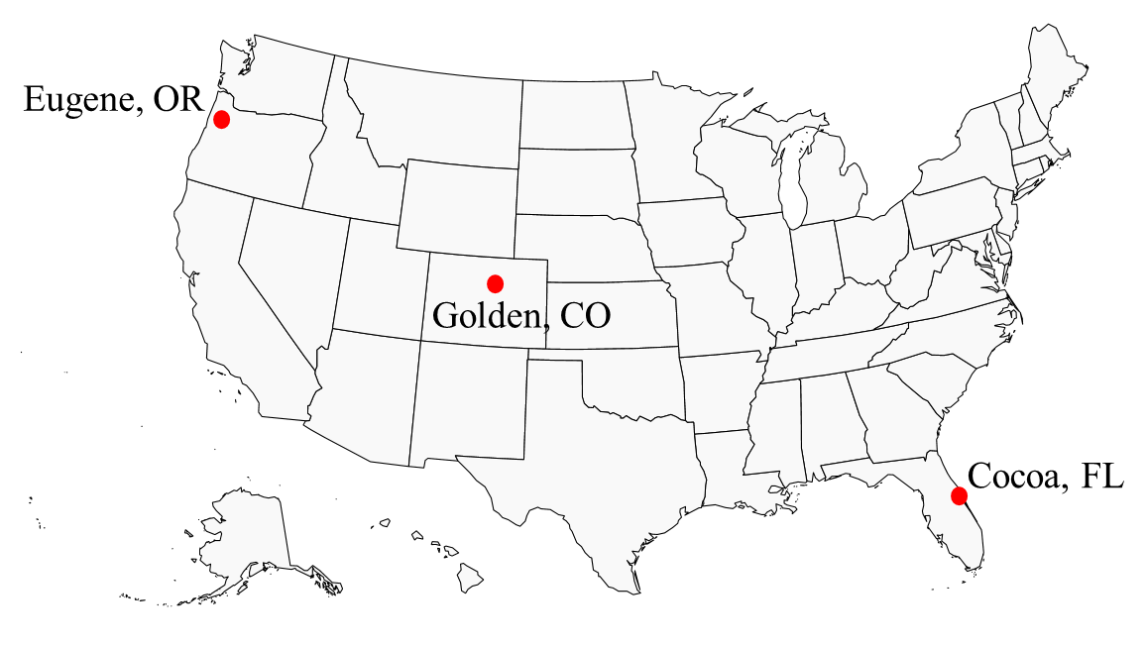

Data Preprocessing
Data Description:
Dataset | Golden, CO | Cocoa, FL | Eugene, OR | Canberra
Country | USA | USA | USA | Australia
Climate type | Semi-arid | Subtropical | Marine coast | Oceanic
Latitude (°, -S) | 39.74 | 28.39 | 44.05 | -35.16
Longitude (°, -W) | -105.18 | -80.46 | -123.07 | 149.06
Elevation above sea (m) | 1798 | 12 | 145 | 595
Number of panels | 11 | 11 | 11 | 8
Panel tilt (°) from horizontal | 40 | 28.5 | 44 | 36
Panel orientation (°) clockwise from North | 180 | 180 | 180 | 38
Total capacity (W) | 1252 | 1272 | 1290 | 1560
Time period of observations | Aug. 2012 to Sep. 2013 | Jan. 2011 to March 2012 | Dec. 2012 to Jan. 2014 | April 2012 to May 2014
Data resolution | 15min | 5min | 5min | 1hr
Missing (% of observations) | 18% | 17% | 10% | 0%
Variability (data resolution) Std.Div. | (15min) 0.256 (1hr) 0.119 | (5min) 0.251 (1hr) 0.164 | (5min) 0.250 (1hr) 0.161 | (1hr) 0.259
B. Marion, A. Anderberg, C. Deline, J. del Cueto, M. Muller, G. Perrin, J. Rodriguez, S. Rummel, T. J. Silverman, F. Vignola, et al., New data set forvalidating pv module performance models," in Photovoltaic Specialist Conference (PVSC), 2014 IEEE 40th, pp. 1362{1366, IEEE, 2014.
https://crowdanalytix.com/contests/global-energy-forecasting-competition-2014-probabilistic-solar-power-forecasting

Slide 13
Methodology
Ensemble Forecasts: Combining Various Models
Individual Forecasts of PV Solar Power Ramp Events
Model A
Ensemble Learning (RF) for Combining of Forecasts
Model B
Combined Forecasts
Model N
Weather Data
General diagram of combining different models
F_{comb}=W_{A}*M_{A}+ W_{B}*M_{B} + W_{C}*M_{C} ….+ W_{N}*M_{N}
Method of Combining The Models
Random forest (RF) is chosen to be the ensemble learning method for combining the various models’ outcomes.
T. Hastie, R. Tibshirani, J. Friedman, and others, The elements of statistical learning, 2nd Edition. Springer-Verlag New York, 2009.

Slide 14



Modeling and Results
Combined Forecasts of Ramps
Implementing several classification models to forecasts solar power ramp events
Objective: Increase the true events, Decrease the false events.
$$True Events$$
& F$alse Events$
Ramp Classes as following:
Class1: Ramp up of high rate, $\text{|}\text{rate}\text{|}≥$ Tsh
Class2: Ramp up of low rate, |rate|$<$ Tsh
Class3: Ramp down of high rate, |rate|$≥$Tsh
Class4: Ramp down of low rate, |rate|$<$ Tsh
Classes of solar power ramp events in the case study
Distribution of the classes of solar power ramp events at threshold (Tsh) =0.4pu/hr.

Slide 15
Modeling and Results
Combined Forecasts of Ramps
Data projection onto PC1 and PC2:
Threshold=0.4pu/hr
For clarity, low-rate classes (2&4) become as a one class, class3: ➔
Class | Class1 | Class2 | Class3 | Total
Samples | 131 | 31 | 3666 | 3828
1) All 14 weather variables
2) All 30 Features (add solar power forecasts)
3) All 50 Features (add ramp rates of forecasts)
4) All 66 Features (add class labels of forecasts)
15

Slide 16
Modeling and Results
Combined Forecasts of Ramps
Method | Naïve Bayes | LDA | Decision Trees | kNN | Logistic Regression | Random Forest | SVM | ANN | Combined Classifiers
Precision (%) | 62% | 65% | 73% | 68% | 79% | 79% | 77% | 70% | 79%
Recall (%) | 43% | 40% | 38% | 31% | 30% | 43% | 43% | 38% | 50%
Balanced Precision (%) | 75% | 78% | 80% | 78% | 59% | 80% | 80% | 78% | 87%
F1-Score (%) | 51% | 49% | 50% | 43% | 44% | 56% | 55% | 49% | 61%
Diff. Index | 27 | 30 | 38 | 27 | 36 | 51 | 48 | 35 | 60
Solar power ramp event forecasts of the high-rate ramp events, (|Rate| ≥ 0.4 pu/hr = 162 events)
by the classification techniques.
16

Slide 17
Modeling and Results
Combined Forecasts of Ramps
Implementing the adjusting approach to forecasts solar power ramp events
 | Persistence, PV1 | NARX | Simple Average (NARX, MLR, ANN, SVR) | Combined (Pers.1, MLR, ANN, SVR) | Adjust Approach (Pers.1, MLR, ANN, SVR) | Combined (Pers.1&3 +NARX, Clouds, MLR, ANN, SVR) | Adjust Approach (Pers.1&3 +NARX, Clouds, MLR, ANN, SVR) | Probabilistic Forecasts (Q1 to Q99) | Probabilistic Forecasts (Q25 to Q75)
Precision (%) | 0% | 45% | 67% | 74% | 75% | 81% | 87% | 88% | 81%
Recall (%) | 0% | 6% | 32% | 28% | 39% | 49% | 51% | 53% | 67%
Balanced Precision (%) | 34% | 61% | 80% | 79% | 83% | 81% | 86% | 90% | 88%
F1-Score (%) | 0% | 10% | 43% | 41% | 51% | 64% | 64% | 66% | 73%
Diff(True-False) | 0 | -2 | 26 | 30 | 42 | 61 | 71 | 74 | 83
Solar power ramp event forecasts of the high-rate ramp events, (|Rate| ≥ 0.4 pu/hr = 162 events) by the adjusting approach

Slide 18
Modeling and Results
Comparison of Hourly Forecasts
Comparison the hourly forecasts of solar power by the adjusting approach with different datasets
Location | Australia | Golden, CO | Cocoa, FL | Eugene, OR
RMSE | 0.0523 | 0.0453 | 0.0420 | 0.0411
Pinball | 0.0084 | 0.0124 | 0.0109 | 0.0106
Specifications of solar PV systems and data statistics
Dataset | Golden, CO | Cocoa, FL | Eugene, OR | Canberra
Country | USA | USA | USA | Australia
Climate type | Semi-arid | Subtropical | Marine coast | Oceanic
Latitude (°, -S) | 39.74 | 28.39 | 44.05 | -35.16
Longitude (°, -W) | -105.18 | -80.46 | -123.07 | 149.06
Elevation above sea (m) | 1798 | 12 | 145 | 595
Number of panels | 11 | 11 | 11 | 8
Panel tilt (°) from horizontal | 40 | 28.5 | 44 | 36
Panel orientation (°) clockwise from North | 180 | 180 | 180 | 38
Total capacity (W) | 1252 | 1272 | 1290 | 1560
Time period of observations | Aug. 2012 to Sep. 2013 | Jan. 2011 to March 2012 | Dec. 2012 to Jan. 2014 | April 2012 to May 2014
Data resolution | 15min | 5min | 5min | 1hr
Missing (% of observations) | 18% | 17% | 10% | 0%
Variability (data resolution) Std.Div. | (15min) 0.256 (1hr) 0.119 | (5min) 0.251 (1hr) 0.164 | (5min) 0.250 (1hr) 0.161 | (1hr) 0.259

Slide 19
Conclusions
The adjusting approach improves the combined forecasts.
The approach is simple vs. the classification techniques.
Ramp classes more separable with features: forecasts, ramp-rates, clouds, neighboring PVs.
Most effective weather variables:
Cloud information: cloud type, height and cloud formation.
Clear-sky solar irradiance / Top solar irradiance at Earth's atmospheric layer.
Diff. Index of high-rate ramps is efficient for the imbalanced classification.
Probabilistic forecasts as a tool of situational awareness.

Slide 20


Thanks for Your Listening
Any Question?
A Post-processing Approach for Solar Power Combined Forecasts of Ramp Events
Mohamed Ali Abuella
mabuella@uncc.edu
https://epic.uncc.edu
Energy Production and Infrastructure Center
University of North Carolina at Charlotte

